Slide 1
BCS1520: Statistics
Lecture 03: Inductive Inference and the Bell Curve

Slide 2

Recap Quiz

Slide 3
Soup
How much soup do I need to drink to know if I need to add some salt?
George Gallup, the inventor of the opinion poll, said a spoonful will do, if you give it a good stir.

Slide 4
Inductive Inference, or, Knowing if there is enough salt from a spoonful of soup
(1) Possible Data
(2) Sample
(3) Study Population
(4) Target Population
Liquid in pot of soup.
Grab a spoon and dip it in a few times.
A few spoonful’s of soup.
Enough salt in all soup?
Notes:
Induction is about taking particular instances and trying to work out general conclusions. For example, suppose we don’t know the customs in a community about kissing female friends on the cheek, and we have to try to work it out by observing whether people kiss once, twice, three times, or not at all. The crucial distinction is that deduction is logically certain, whereas induction is generally uncertain.

Slide 5
Inductive Inference, or, Knowing if there is enough salt from a spoonful of soup
(1) Possible Data
(2) Sample
(3) Study Population
(4) Target Population
Liquid in pot of soup.
Grab a spoon and dip it in a few times.
A few spoonful’s of soup.
Enough salt in all soup?
From (1) to (2): Will a spoon of soup be enough? Will the spoon get enough soup or is it not enough for us to taste it well?
Notes:
Problems of measurement.

Slide 6
What do we want from our measurements?
Reliable: Low variability across occasions given same context.
Valid: Measuring what you intend to measure, or at least close to it.
For example: We want to be careful about positive vs negative framing for survey questions.

Slide 7
Inductive Inference, or, Knowing if there is enough salt from a spoonful of soup
(1) Possible Data
(2) Sample
(3) Study Population
(4) Target Population
Liquid in pot of soup.
Grab a spoon and dip it in a few times.
A few spoonful’s of soup.
Enough salt in all soup?
From (2) to (3): Will we be able to sample enough of the soup? Called internal validity: the idea that we sample the soup enough to get a taste for how much salt is in the soup.
Notes:
Here we need to think about whether we sampled appropriately. It may well be for example that because of the heat at the bottom of the soup, saltiness levels are different there so if we haven’t accounted for that then we cannot say we have done well at capturing the study population.
Also, we could just drink all the soup but then there’s no soup. This is true for this specific case of course but there can be similar constraints in other situations.

Slide 8
Inductive Inference, or, Knowing if there is enough salt from a spoonful of soup
(1) Possible Data
(2) Sample
(3) Study Population
(4) Target Population
Liquid in pot of soup.
Grab a spoon and dip it in a few times.
A few spoonful’s of soup.
Enough salt in all soup?
From (2) to (3), ensuring internal validity: By sampling randomly we do a better job of ensuring we check all the soup, even if the soup is chunky.
Notes:
Thought about this when we were discussing how we measure the number of laptops in the building. We would get better internal validity there if we chose rooms at random.

Slide 9
Lack of Internal Validity
Bias in machine learning algorithms that try to sort resumes/CVs
Allowing only men to vote
If when choosing who goes to war, you don’t shuffle the box of names which were alphabetized.
Polling yielding only people who want to respond causing poor predictions.

Slide 10
Inductive Inference, or, Knowing if there is enough salt from a spoonful of soup
(1) Possible Data
(2) Sample
(3) Study Population
(4) Target Population
Liquid in pot of soup.
Grab a spoon and dip it in a few times.
A few spoonful’s of soup.
Enough salt in all soup?
From (3) to (4): Is our assessment of ALL the soup valid from our random sampling? Called external validity: the idea that we can generalize from our limited sampling to all the soup.
Notes:
External validity is especially a concern when thinking about drugs primarily tested on animals. Or if the drug is only tested on men.

Slide 11
Lack of External Validity
If in a survey to assess dietary choices, we only polled men.
Or, if we are testing a new drug, but only tested them on mice. Might be good at judging the study population, but not the target population.

Slide 12
Inductive Inference, or, Knowing if there is enough salt from a spoonful of soup
(1) Data
(2) Sample
(3) Study Population
(4) Target Population
Liquid in pot of soup.
Grab a spoon and dip it in a few times.
A few spoonful’s of soup.
Enough salt in all soup?
From (3) to (4), assessing external validity: When can this go wrong?
Consider the following case: Our soup has a lot of oil or cream and we only sample from the top of the soup where all the oil/cream is, then we don’t have external validity.

Slide 13
Inductive Inference, or, Knowing if there is enough salt from a spoonful of soup
(1) Data
(2) Sample
(3) Study Population
(4) Target Population
Liquid in pot of soup.
Grab a spoon and dip it in a few times.
A few spoonful’s of soup.
Enough salt in all soup?
What, then, is inductive inference?
We want to learn general principles about the world from specific examples. There is uncertainty associated with this, as opposed to deductive inference.
Notes:
Although in mathematics generally induction is now being placed under deduction. Induction based proofs do not in fact have this element of uncertainty about them. Inductive inference, inference being the key term here, does.

Slide 14
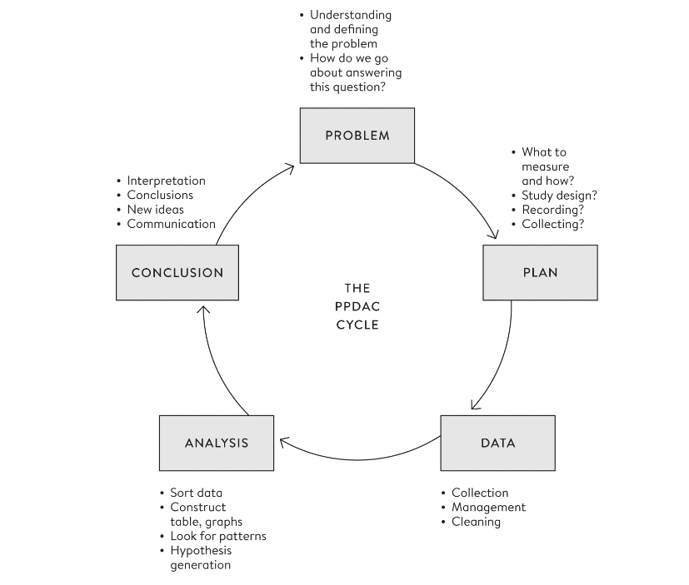
Notes:
Where are we in the PPDAC?

Slide 15
What is the chance of an 8-pound baby?
The infamous bell curve could be useful to tell us.
Let’s try to create a population distribution:
Definition
Population Distribution refers to the spread of data for the population, as opposed to the sample, over a number line describing how often, for example, we can expect to get too salty spoonsful of soup.

Slide 16
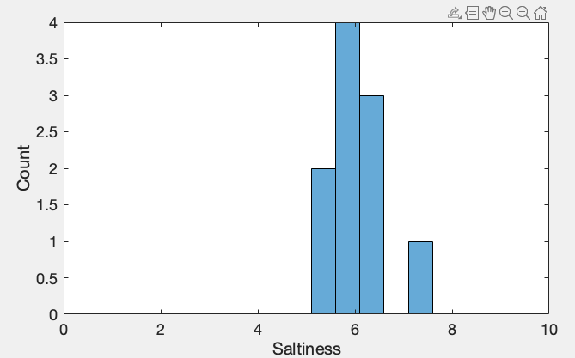
What is the chance of an 8-pound baby?
We measure the weights of 10 babies.

Slide 17
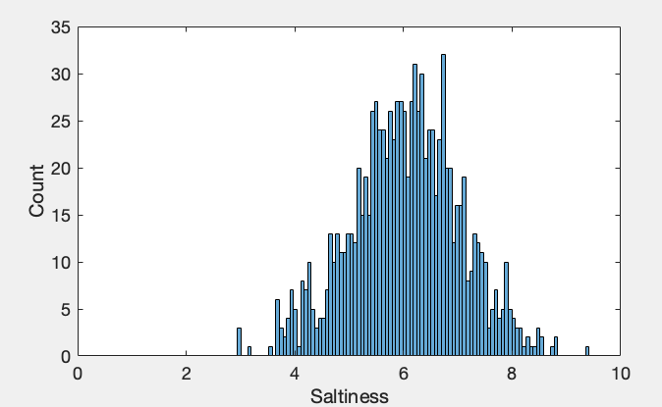
What is the chance of an 8-pound baby?
Let’s now measure the weights of 1000:

Slide 18
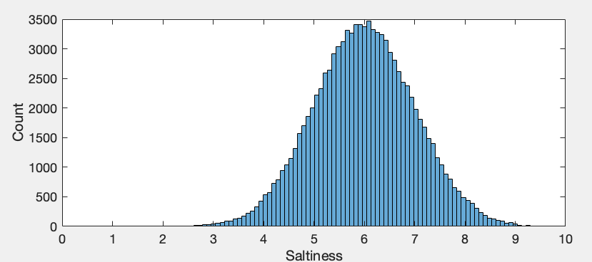
What is the chance of an 8-pound baby?
And now 100000 times:

Slide 19
What is the chance of an 8-pound baby?
Here is a bell curve (Gaussian/normal distribution).
We can describe it with the mean = 6.
And the standard deviation = 1.
Bell curves are fully characterized by these two numbers.
Notes:
Arises when the outcome is influenced by many small influences, like a complex phenotype such as height being influenced by lots of genes.

Slide 20
What is the chance of an 8-pound baby?
So how likely are we to have a baby weight greater than 8? Visually it appears low, but we can quantify this!

Slide 21
What is the chance of an 8-pound baby?
How can we estimate the probability of weight > 8?
We will count how many times we see a value > 8 and divide that by the total.

Slide 22
What is the chance of an 8-pound baby?
Total count greater than 8 = 2340.
Total number of samples = ??
Probability of weights > 8 = 2340/?? = 0.0234

Slide 23
What is the chance of an 8-pound baby?
Probability of weight > 8 ~= 0.0234, 2 in 100 babies weight more than 8 pounds.
We can estimate this using a formula for a curve that looks like the figure below.

Slide 24
What is the chance of an 8-pound baby?
Since we defined the mean and the standard deviation, we can predict the probability of babies in a different country weighing more than 8 pounds WITHOUT sampling 100000 times!
8 is 2 standard deviations away from the mean of 6.
For ANY bell curve, data outside 2 standard deviations away means a probability of ~5 percent

Slide 25
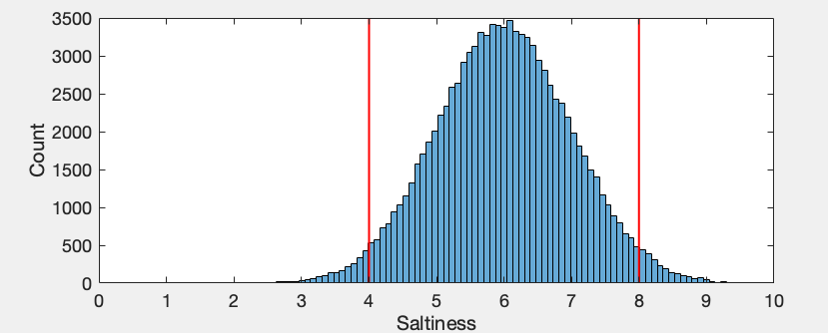
What is the chance of an 8-pound baby?
For ANY bell curve, data outside 2 standard deviations away means a probability of ~5 percent
Notes:
Sum of the counts in the areas in the red rectangles over the total = 5%

Slide 26
What is the chance of an 8-pound baby?
The amount in the area beyond 8 = ??
Notes:
Sum of the counts in the areas in the red rectangles over the total = 5%

Slide 27
What is the chance of an 8-pound baby?
The amount in the area beyond 8 = 2.5% (5/2)
This is very similar to our estimate of 2.34% from our sample.
Notes:
Then we can say that it is only once in 50 spoons you get a salty spoonful, so you hopefully won’t notice that.

Slide 28
What else can we say about weights of babies?
We have a sense for how often babies are born at different weights.
On average (mean), babies weight 6 pounds – which is medically alright.
For any random baby, the baby may be medically in a dangerous weight zone (< 4) 2.5 % of the time.
Notes:
Then we can say that it is only once in 50 spoons you get a salty spoonful, so you hopefully won’t notice that.

Slide 29
What else can we say about weights of babies?
We summarized our distribution using the parameters mean and standard deviation because we knew it was a symmetric bell curve.
Sometimes, percentiles can be better: 8 was at the 97.5 percentile meaning only 2.5% of the samples lay beyond it.
Notes:
Sum of the counts in the areas in the red rectangles over the total = 5%

Slide 30
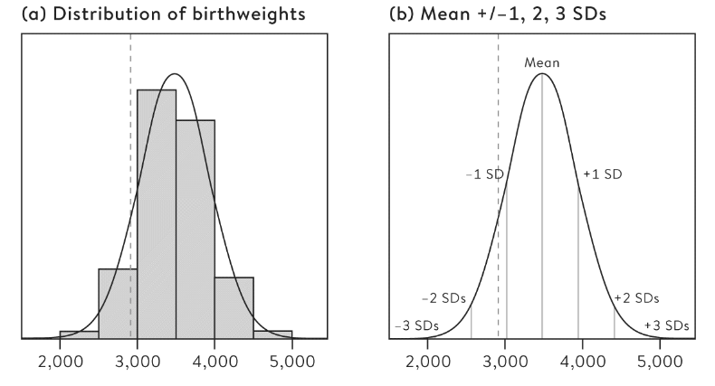
Birth Weights
Statistics are summaries of data.
Parameters are values about the population – an abstraction that we use to understand new data points.
Notes:
The distribution of birth weights of 1,096,277 children of non-Hispanic white women in the US in 2013, born at 39–40 weeks’ gestation, with a normal curve with the same mean and standard deviation as the recording weights in the population. A baby weighing 2,910g is shown as the dashed line.
Normali distribution is fully characterized by the mean and standard deviation which is quite an amazing way to reduce a massive dataset. If we can explain it with just those two variables.
What is a z-score? 2910 g is at 1.2 standard deviations below mean.

Slide 31
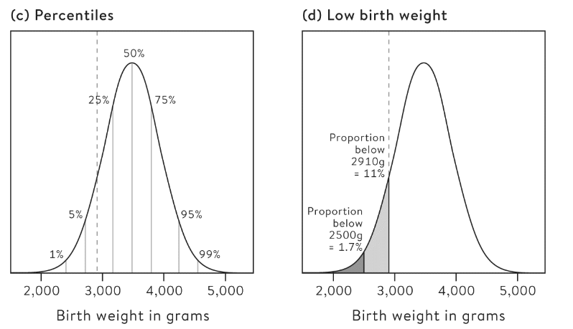
Birth Weights
Notes:
Now we are looking at a population. From the sample we made some inference about the population.
Proportion is also the probability.
Population is representing a full group of individuals but already in the abstract – it refers to some ideal distribution – like how no circle you draw will ever be a true circle.
This distribution is called a probability distribution for a random observation of birth weight.

Slide 32
What is the population?
Literal population: The voting citizens of country when polling; the whole pot of soup.
Virtual population: An imagined population when we could potentially have sampled infinitely e.g. when measuring someone’s temperature.
Metaphorical population: When we have all possible data, but pretend it came from a “population”.

Slide 33
What is the population?
Metaphorical population: When we have all possible data, but pretend it came from a “population”.
This can be true when measuring the survival rate from all the hospitals. We have covered the population, but we can pretend there are alternative universes where the rate was different.

Slide 34
The World is Random
A useful statistical reasoning strategy then is to pretend everything that happens has some random chance of happening.
How random? That is, thinking in terms of the bell curve, how many standard deviations from the mean was it?
That is something we need to figure out with modeling.

